Slide 1
INFORMATION GATHERING
Original From:
Object-Oriented Systems Analysis And Design With UML
By Robert V. Stumpf
And
Lavette C. Teague
Expanded by: Ferreiras.

Slide 2


INFORMATION GATHERING
Analyst
[Detective]
Users
[Suspects]

Slide 3
Analyst-User Vs.
Detective-Suspect
“
When we are gathering information, analysts are like detectives and users are like elusive suspects. They know that there is a problem to be solved and therefore they must look for clues that uncover the solution.
“

Slide 4
WHY INFORMATION GATHERING ?
The system concept starts as a fuzzy set of ideas that are gradually worked and reworked into a viable concept system proposal. Very detailed information must be gathered from the users to have a well-understood meaning of the system proposal.

Slide 5

The Information Gathering clear up the system concept
System
Concept
Proposal
Information
Gathering

Slide 6

 The system analyst conducts an information gathering to study the system request and to prepare the Conceptual System Proposal.
System
Request

Slide 7
 The analyst gathers facts about the problem or opportunity, project scope and constraints, project benefits, and estimated development time and costs. The end product is the Conceptual System Proposal.

Slide 8
Model of an Information Gathering.
Project Scope
and Constraints
System
Concept
Proposal
Information
Gathering
Problem or
Opportunity
Project
benefits
Development
time and costs

Slide 9
Interaction with Managers and users.
You should meet with key managers, users and IT staff to describe the project, explain your responsibilities, answer questions, and invite comments.

Slide 10
Interaction with Managers and users.
To beginning the information gathering activities, a memo or an e-mail message should let people know about the investigation and explain your role. This starts an important dialogues with users that will continue throughout the entire development process.

Slide 11
Interaction with Managers and users.
A system project often produces significant changes in company operations. Employees may be curious, concerned, or even opposed to those changes. It is not surprising to encounter some user resistance during a information gathering process. Employee attitudes and reactions are important and must be considered.

Slide 12
Careful with the word “problem”
When interacting with users, you should be careful in your use of the word problem, because generally it has a negative meaning. When you ask users about problem, some will stress current system limitations rather than desirable new features or enhancements.

Slide 13
Careful with the word “problem”
Instead of focusing on difficulties, you should question users about additional capability they would like to have. Using this approach, you highlight ways to improve the user's job, you get a better understanding, more positive relationships with users.

Slide 14
Learning Objectives
Identify the drivers of information gathering during system development.
Describe some of the principal sources
of information for systems analysis.
Discuss the advantages and disadvantages of gathering information through interviews, questionnaires, and observation.

Slide 15
Learning Objectives
(continued)
Summarize how to prepare for an interview.
Discuss advantages and disadvantages of using joint application development during analysis and design.
Explain important considerations in evaluating information gathered for use in system development.

Slide 16
Learning Objectives
(continued)
Summarize some key concerns in communicating information.
State what you should do when preparing an oral presentation.

Slide 17
Overview
The process of information system development depends on effective gathering, management, and communication of information.
Gathering information to specify users’ requirements is driven by the needs of the UML models which describe those requirements.

Slide 18
Overview
(continued)
Analysts gather information from a variety of sources, including
people and documents.
Multiple information sources increase confidence in the relevance and reliability of the information.
Interviews, questionnaires, and observation are the principal
methods of gathering information.

Slide 19
Overview
(continued)
Regardless of its source or the
methods used to gather it,
information must always be
evaluated for content, meaning, relevance, and reliability.
Automated aids to information management can help cope with
the quantity and complexity of
information needed during development.

Slide 20
Overview
(continued)
Effective written, oral, and graphic communication skills are essential
not only to successful system developers, but also to the success
of the projects on which they work.

Slide 21
Gathering Information
Most of the information gathered by the development team must come from
the users who own the information.

Slide 22
Gathering Information
(continued)
The critical information for object-oriented systems analysis is the information needed to:
carry out event analysis,
identify the use cases,
write the expanded use case narratives, and
construct the domain model.

Slide 23
Information Sources
Documents and displays describing the current system if is so or the idea;
Other publications from the
organization, such as annual
reports and brochures
Publications from the industry
People, especially the users

Slide 24
Information-Gathering Methods
Interviews
Questionnaires
Observation

Slide 25
Interviews
Are the primary method of obtaining information during the information gathering process. The interviewing process involves a series of steps:

Slide 26
Interviews
The steps:
1. Determine the people to interview;
2. Establish objectives for the interview;
3. Develop interview questions;
4. Prepare for the interview;
5. Conduct the interview;
6. Document the interview;
7. Evaluate the interview

Slide 27
Interviews
Analyze Organization Charts
In many instances, you will not know the organizational structure of departments, involve in the study. You should obtain organization charts to understand how the department functions and identify individuals you might want to interview.

Slide 28
Interviews
An interview is a conversation in which questions are asked to gather information.
Components of an interview:
Prepare for the interview.
Conduct the interview.
Summarize and evaluate the interview.

Slide 29
Questionnaires
A questionnaire is a list of questions to which written answers are requested from several respondents.
If the questions are asked orally, this technique is called a survey.
A questionnaire is shorter and more highly structured than an interview.

Slide 30
Questionnaires
(continued)
The design of a questionnaire requires great care.
A statistician should prescribe the procedure for selecting the recipients
in order to assure that the sample is representative.
A statistician may also be helpful in interpreting the results after the
replies have been tabulated.

Slide 31
Joint Application Development
Joint Application Development (JAD) involves users and developers in intensive workshops.
It has been used most often to define system requirements and a preliminary system design.

Slide 32

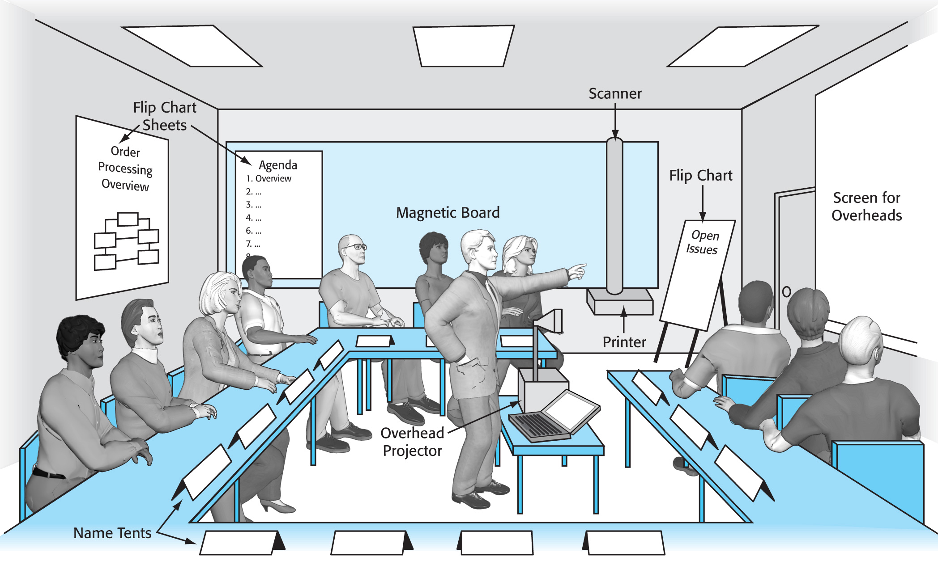
Joint Application Development (continued)
.

Slide 33
Joint Application Development (continued)
JAD participants include:
An executive sponsor
An impartial facilitator
A scribe
Full-time participants
On-call participants
Observers

Slide 34
Joint Application Development (continued)
JAD helps:
give users a sense of ownership of the system;
users understand the technical issues in the development process;
facilitate decisions because the critical decision makers participate.

Slide 35
Joint Application Development (continued)
JAD requires:
Intensive and time-consuming participation
Careful planning
Careful review and approval of the decisions made during the session
Realistic expectations from the participants

Slide 36
Evaluating Information
What does the information say?
Summarize the information content.
What does the information mean?
Evaluate its implications, relationships, and consistency. Does it state fact, opinion, perceptions, or feelings?

Slide 37
Evaluating Information
(continued)
Is the information relevant?
What does it contribute to specifying the requirements?
Is the information reliable?
Is it outdated, deliberately misleading, self-serving, or biased by its source
or by the methods used to gather it?
Independent sources and multiple methods of gathering information provide some cross-checks.

Slide 38
Managing Information
Information management during system development is necessary because of:
the quantity of the information
the complexity of the information
the iterative nature of development
the need to maintain the identity and integrity of documents and models throughout the process

Slide 39
Managing Information
(continued)
Manual Methods
Organized files
Legible records
Minimal redundancy
Automated Aids
Word-processing software
Graphics software
Database management systems
Integrated development
environments (IDEs)

Slide 40
Reporting Information
Principal modes of communication:
Written reports
Feasibility report, use case narratives, walkthrough findings
Oral reports
Management briefings, walkthroughs
Graphic communication – the most effective means
Graphic UML models (activity diagram), -ff-, charts, graphs

Slide 41
Principles of Communication
Know your audience.
Answer the basic questions.
Organize and plan the report or presentation.
Prepare and rehearse the presentation.
Make a final check.
Watch for feedback.

Slide 42
Summary
Gathering, evaluating, managing, and communicating information effectively are critical to successful information system development.
The information needs of the UML models
of users’ requirements determine what information to gather.
Written, oral, and graphic communication skills are all necessary in this effort.

Slide 43
Interviews

Slide 44
Interviews -- Five Basic Steps
Selecting Interviewees
Designing Interview Questions
Preparing for the Interview
Conducting the Interview
Post-Interview Follow-up

Slide 45
Selecting Interviewees
Based on Information Needed
Often Good to Get Different Perspectives
  Managers
  Users
  Ideally, All Key Stakeholders

Slide 46
Types of Questions
 Type: Open-Ended Questions
 Examples:
▪ What do think about the current system?
▪ What are some of the problems you face on a daily basis ?
▪ How do you decide what types of marketing campaign to run?

Slide 47
Types of Questions
 Type: Probing Questions
 Examples:
▪ Why?
▪ Can you give me an example ?
▪ Can you explain that in a bit more detail?

Slide 48
Designing Interview Questions
Unstructured interview
  Broad, Roughly Defined Information
Structured interview
  More Specific Information

Slide 49
Interview Preparation Steps
Prepare General Interview Plan
  List of Question
  Anticipated Answers and Follow-Ups
Confirm Areas of Knowledge
Set Priorities in Case of Time Shortage
Prepare the Interviewee
  Schedule
  Inform of Reason for Interview
  Inform of Areas of Discussion

Slide 50
Conducting the Interview
Appear professional and unbiased
Record all information
Check on organizational policy regarding tape recording
Be sure you understand all issues and terms
Separate facts from opinions
Give interviewee time to ask questions
Be sure to thank the interviewee
End on time

Slide 51
Conducting the Interview
Practical Tips
Don’t Worry, Be Happy
Pay Attention
Summarize Key Points
Be Succinct
Be Honest
Watch Body Language

Slide 52
Post-Interview Follow-Up
Prepare Interview Notes
Prepare Interview Report
Look for Gaps and New Questions

Slide 53
Interview Report
INTERVIEW REPORT
Interview notes approved by: ____________
Person interviewed ______________
Interviewer _______________
Date _______________
Primary Purpose:
Summary of Interview:
Open Items:
Detailed Notes:

Slide 54
JOINT APPLICATION DESIGN (JAD)

Slide 55
JAD Key Ideas
Allows project managers, users, and developers to work together
May reduce scope creep by 50%
Avoids requirements being too specific or too vague

Slide 56
Joint Application Design (JAD) Important Roles
Facilitator
Scribe ( writer, secretary )

Slide 57
Joint Application Design (JAD) Setting
U-Shaped seating
Away from distractions
Whiteboard/flip chart
Prototyping tools
e-JAD

Slide 58
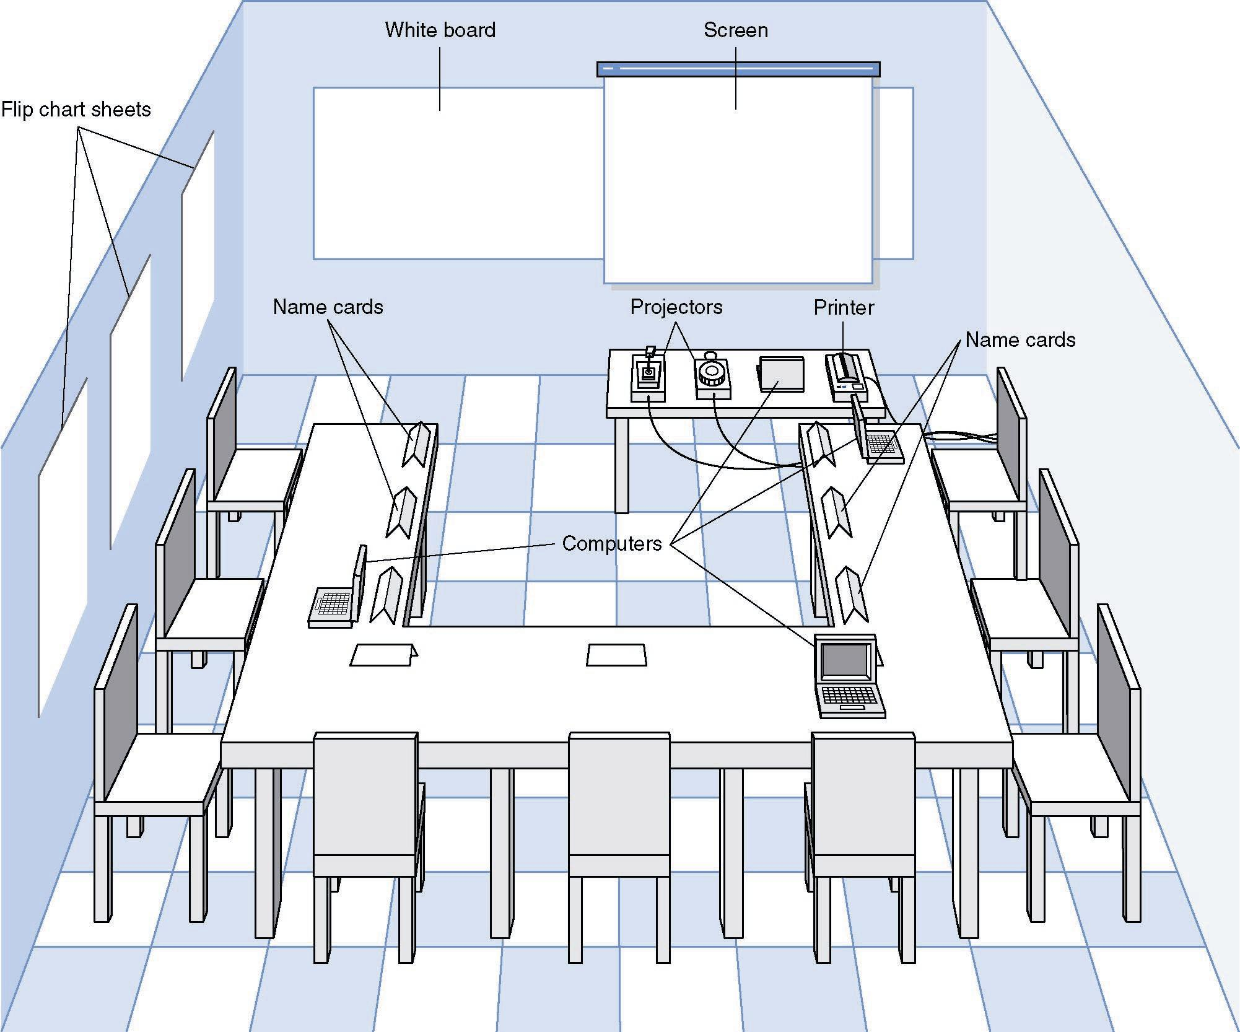
JAD Meeting Room
JPEG Figure 5-5 Goes Here

Slide 59
The JAD Session
Tend to last 5 to 10 days over a three week period
Prepare questions as with interviews
Formal agenda and groundrules
Facilitator activities
  Keep session on track
  Help with technical terms and jargon
  Record group input
  Help resolve issues
Post-session follow-up

Slide 60
Managing Problems in JAD Sessions
Reducing domination
Encouraging non-contributors
Side discussions
Agenda merry-go-round
Violent agreement
Unresolved conflict
True conflict
Use humor

Slide 61
QUESTIONNAIRES

Slide 62
Questionnaire Steps
Selecting participants
  Using samples of the population
Designing the questionnaire
  Careful question selection
Administering the questionnaire
  Working to get good response rate
Questionnaire follow-up
  Send results to participants

Slide 63
Good Questionnaire Design
 Begin with non-threatening and interesting questions
 Group items into logically coherent sections
 Do not put important items at the very end of the questionnaire
 Do not crowd a page with too many items
 Avoid abbreviations
 Avoid biased or suggestive items or terms
 Number questions to avoid confusion
 Pretest the questionnaire to identify confusing questions
 Provide anonymity to respondents

Slide 64
Document Analysis
Provides clues about existing “as-is” system (If an system already exists, -ff-)
Typical documents
  Forms
  Reports
  Policy manuals
Look for user additions to forms
Look for unused form elements

Slide 65
Observation
Users/managers often don’t remember everything they do
Checks validity of information gathered other ways
Behaviors change when people are watched
Careful not to ignore periodic activities
  Weekly … Monthly … Annual

Slide 66
Criteria for Selecting the Appropriate Techniques
Type of information
Depth of information
Breadth of information
Integration of information
User involvement
Cost
Combining techniques

Slide 67
YOUR TURN
Please prepare a interviews for gather information from "your business" which allow to clear your system request. Two person will be in one: You as analyst and you as user.

Slide 68
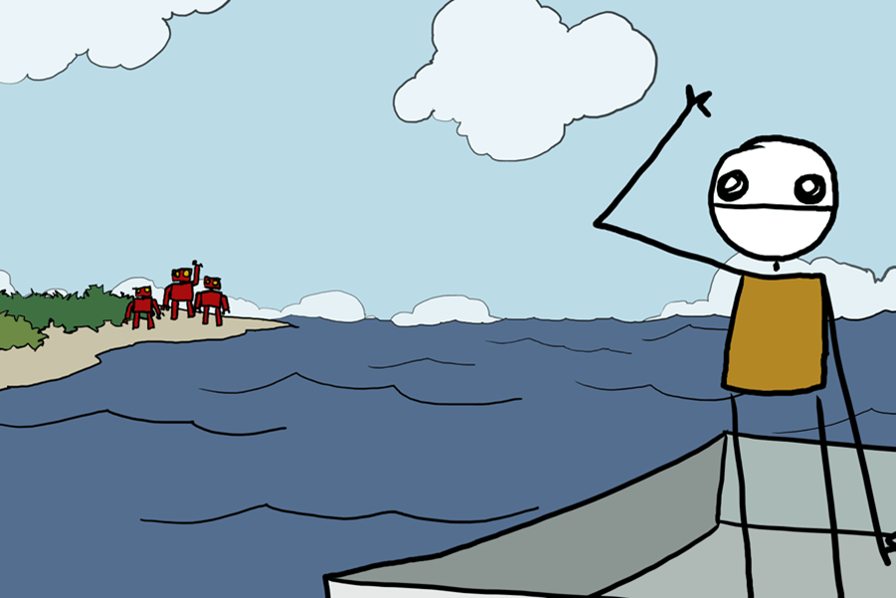
Bye

